Slide 1


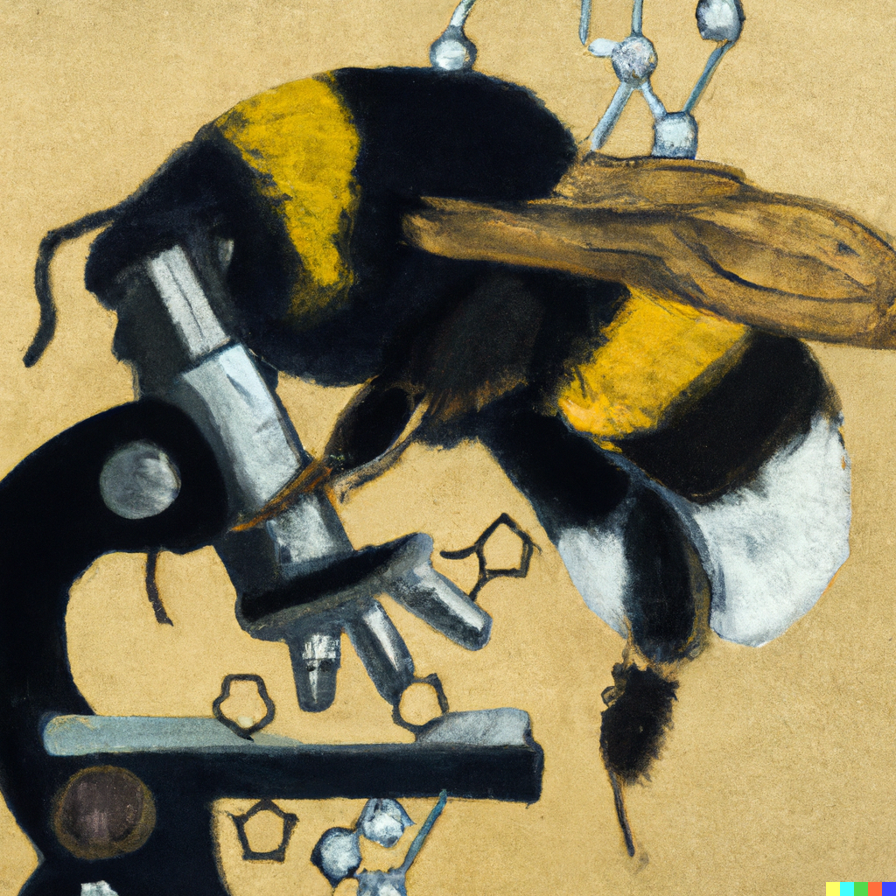
Differential splicing analysis
Joe Colgan
JGU Mainz
tcolgan@uni-mainz.de

Slide 2
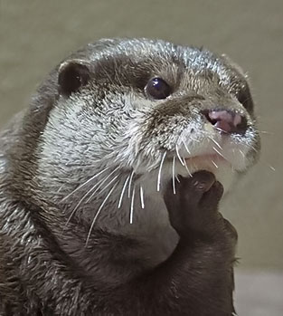


Workshop outline
Introduction into identifying and quantifying splicing events
Processing and visualisation of splicing events

Slide 3

Differential gene expression
Differences in amplitude
(i.e., the amount a gene is transcribed)
Transcripts
Transcription
Gene

Slide 4
Differential gene expression
Changes in amplitude
(i.e., the amount a gene is transcribed)
Changes in isoforms
(i.e., what a gene is transcribing)
Transcripts
Transcription
Gene

Slide 5
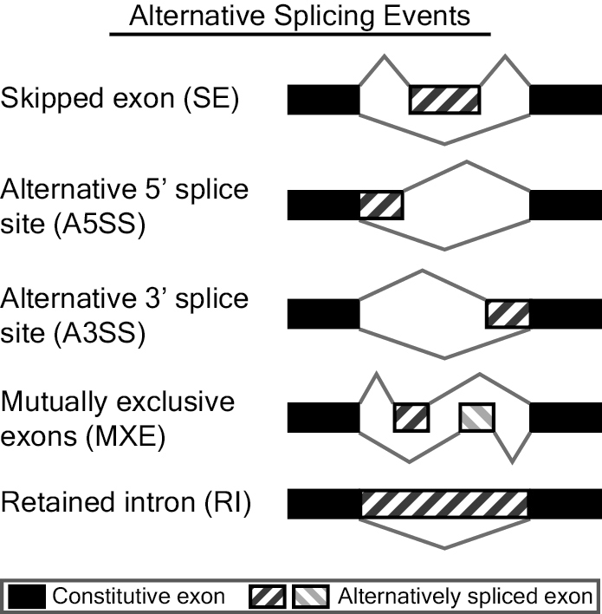
Common splicing events

Slide 6

How can we measure alternative splicing?
The basic principle in RNA-Seq analysis of alternative splicing is to use RNA-Seq reads mapped to different isoforms to estimate the isoform proportion

Slide 7
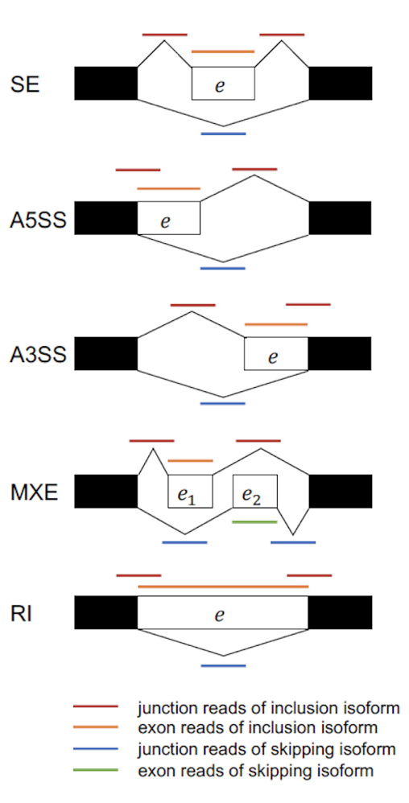
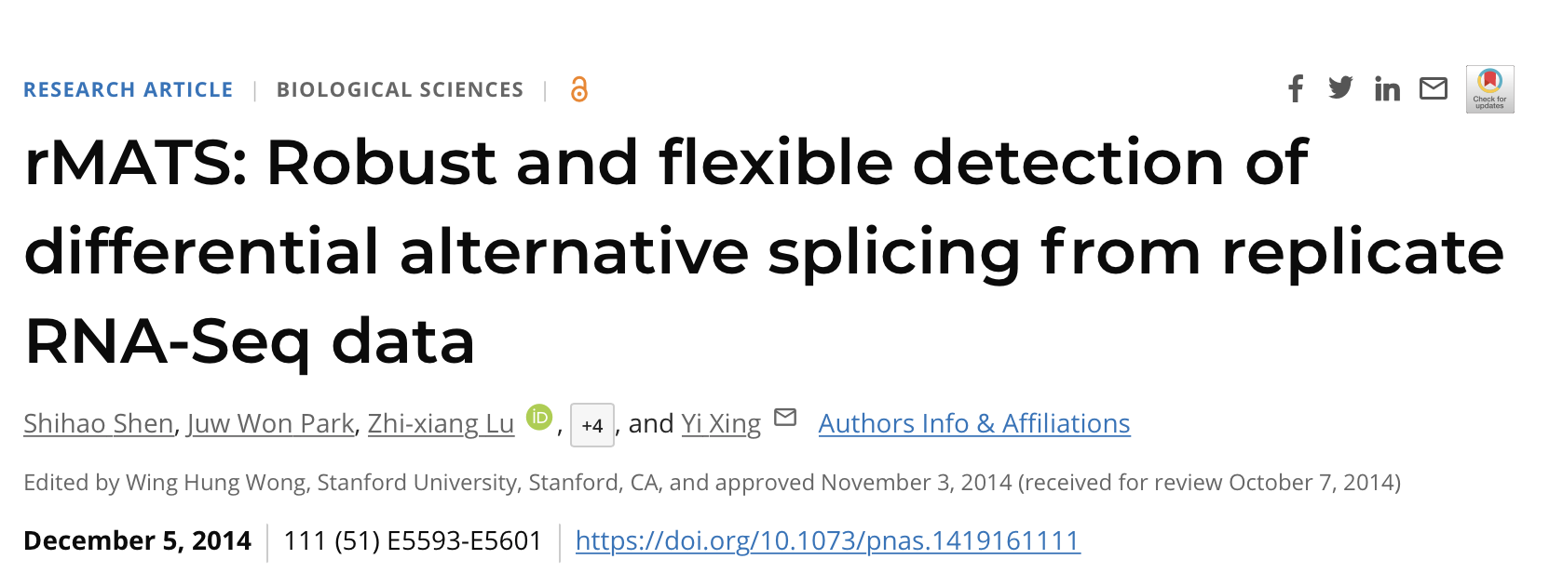
rMATs
Based on MATs (Multivariate analysis of transcript splicing)
Detect differential alternative splicing events from RNA-Seq data.
The statistical model of MATS calculates the P-value and false discovery rate that the difference in the isoform ratio of a gene between two conditions exceeds a given user-defined threshold.
From the RNA-Seq data, MATS can automatically detect and analyze alternative splicing events corresponding to all major types of alternative splicing patterns

Slide 8
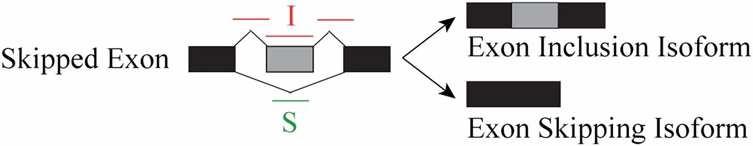
How can we measure alternative splicing?
Percent Spliced in (PSI): Ratio between reads including (I) or excluding exons (S)
Compare between mean PSI between two groups using likelihood ratio test
Website: https://rnaseq-mats.sourceforge.io

Slide 9
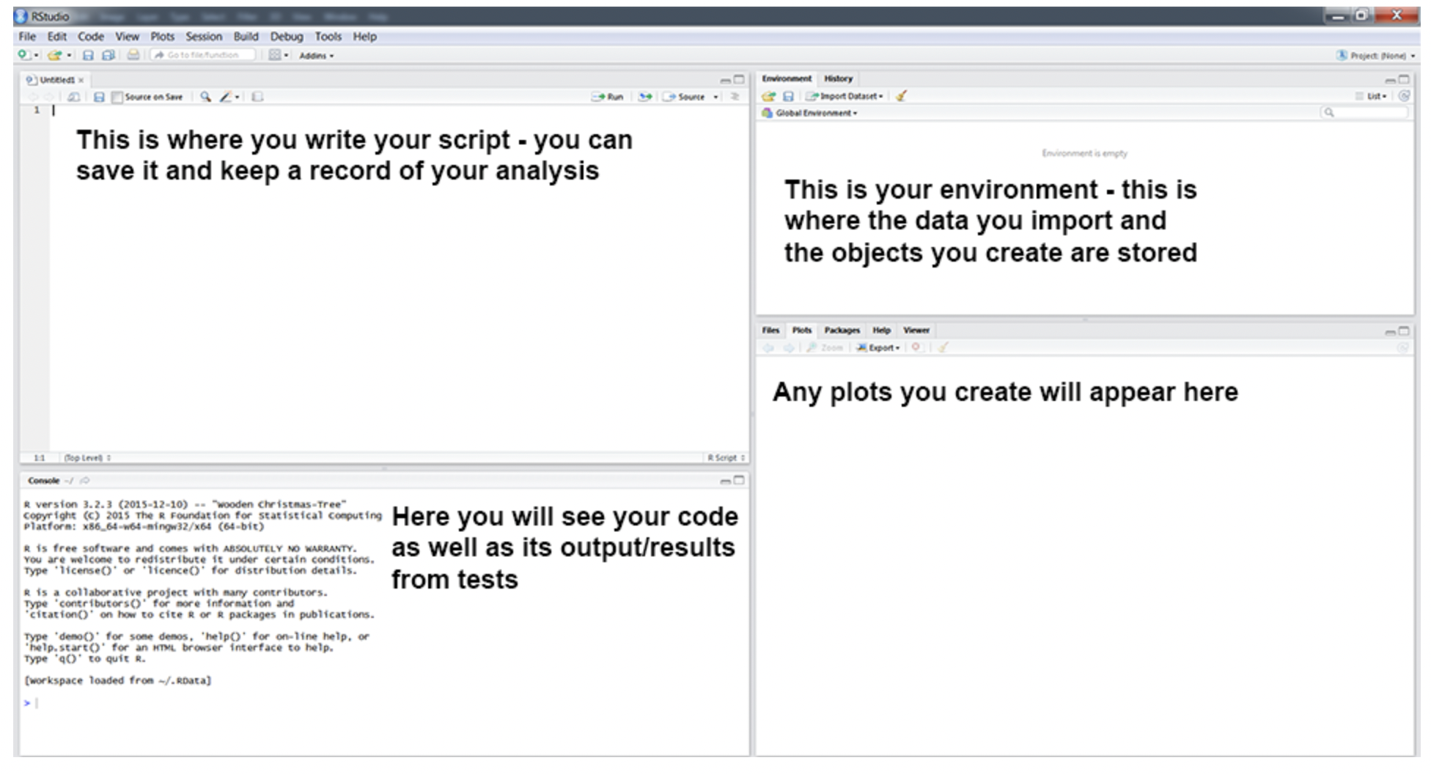
Introduction to R
Today, we will do our analysis in RStudio:
- A standard RStudio consists of four panels

Slide 10
Introduction to R
R is an object-based language
- This means the data you import or values you create during your R session are stored in objects
command
For example:
data <– read.csv(file = “test.csv”)
object
assigner
function
argument
In this command:
- the ‘read.csv()’ takes the file ’test.csv’ as input and assigns the information to the object ‘data’ where the information is stored.
- objects can contain different data such as vectors, data frames, matrices, and lists.

Slide 11
Introduction to R
How data are stored:
-There are four main classes of data:
Integer: only whole numbers (1, 2, 3, 4, 5, 6, 7, 8, 9, 100, 1000, 260000)
Numerical: whole and floating values (0.1, 2.3, 3.5556, 5, 6, 7.8, 8.9, 0.0007)
Character: (‘a’, ‘b’, ’dog’, ‘bee’, ‘1’, ‘7.8’, ‘4000’)
Factor:
Objects where you can add additional information (categories) to your data structure
For example: Categorise cities by country
Cities
Berlin
Paris
Frankfurt
Mainz
London
Country
Germany
France
Germany
Germany
UK
These categories are then known as levels
You can find out the class of an object by using the ‘str()’ command, which stands for structure

Slide 12
Introduction to R
Functions:
There are three main classes of functions:
- Base R functions: these are functions that come already come with Rstudio (e.g., nrow(), dim(), str())
- Package functions: these are functions that come with an R package and the package must be loaded before the function can be used (e.g., ggplot(), dplyr(), euler()).
NB: Sometimes functions from different packages may be called the same name (e.g., plot()) – to ensure you are using the right function, we can specify the function from a particular function by using the syntax: package::function() (e.g., dplyr::select())
- Custom functions: functions that you can write yourself

Slide 13
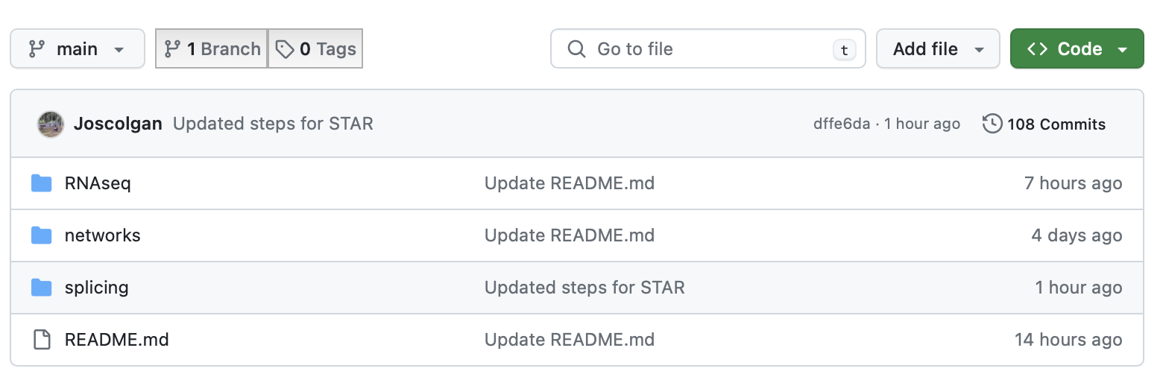
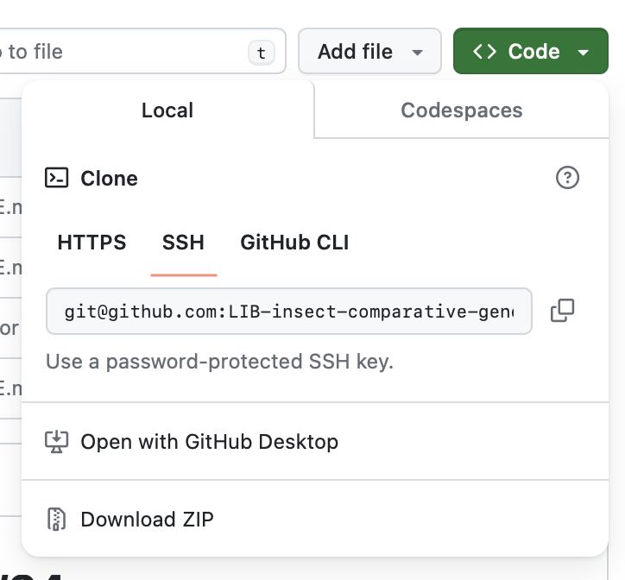
What you have for today
We have a directory on Github that you can download/clone:
https://github.com/LIB-insect-comparative-genomics/RNAseq-workshop2023
git clone git@github.com:LIB-insect-comparative-genomics/RNAseq-workshop2023.git

Slide 14


What you have for today
Working directory
(this is where you should download files to)
splicing
data
doc
input
Rmarkdown templates for each analysis
brain
gonad
Output text files from rMATS
Tutorial PDF and HTML files
RDS files containing DEGs

Slide 15
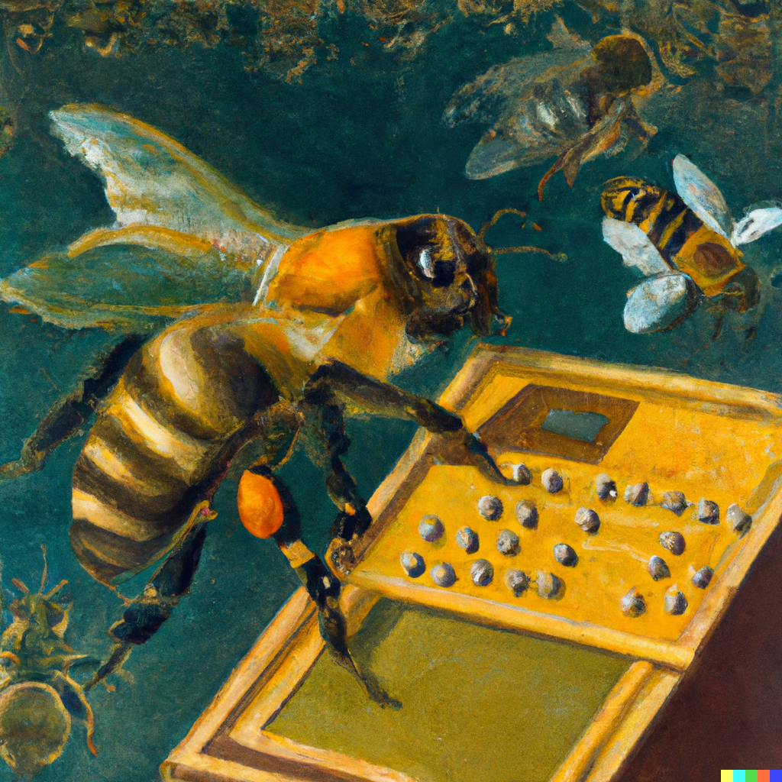



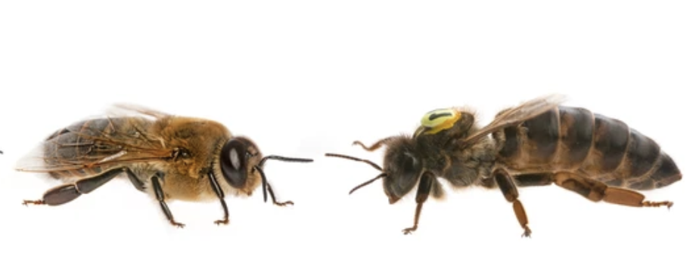
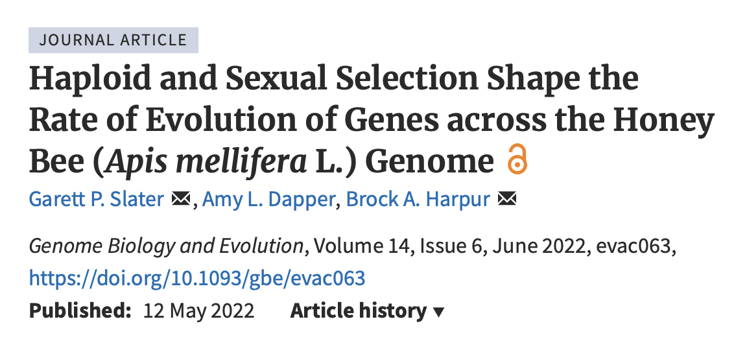
Dataset for today: Honeybees
N = 5
N = 5
N = 4
N = 3
- Reads downloaded from NCBI SRA database [sratool]
- Aligned against latest reference genome [STAR]
- Identification of splicing events [rMATs]
https://academic.oup.com/gbe/article/14/6/evac063/6584681

Slide 16
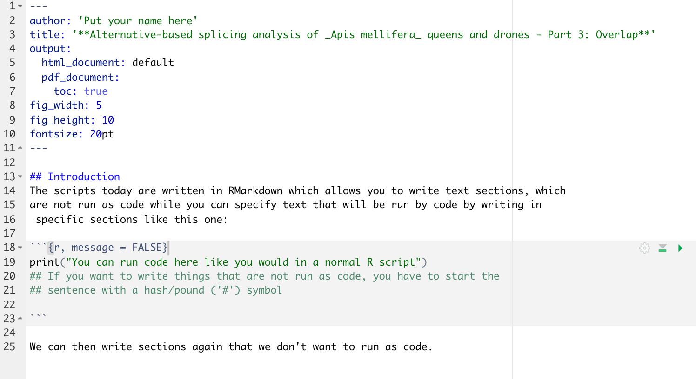
What is an R Markdown script?
It looks like a fancier version of a regular R script but has some great features:
- You can clearly separate sections with and without code (easier to read and add notes/annotations)
- Using the knitR function, you can convert your script into a html, PDF, or word document

Slide 17
What you have for today
We have three analyses today – three scripts that we want you to work through that will cover:
- Processing and visualising results of splicing events between queens and males for two tissues (brains and gonads)
- Comparison between alternatively spliced genes and those that differ in amplitude

Slide 18

Helpful resources for self-learning
- Structuring folders for computational analyses
- Improving in R and statistics (https://ourcodingclub.github.io)
- Introduction to Unix shell
(https://swcarpentry.github.io/shell-novice/)
- Statistics & Machine learning (https://www.youtube.com/@statquest)
- Scripts for non-model organisms (mainly bees and fish): https://github.com/Joscolgan
Questions or feedback: tcolgan@uni-mainz.de

